Slide 1

A PROJECT PRESENTATION ON SOCIAL MEDIA FAKE NEWS DETECTION USING MACHINE LEARNING
Presented By
Vandita Singh Gautam (1900970100125)
Shanu Katiyar (1900970100108)
Guided By
Dr. Kavita Sharma
Department of Computer Science & Engineering
Galgotias College of Engineering & Technology , Greater Noida

Slide 2
Outline
Introduction
Literature Survey
Objective
Problem Identification
Workflow Diagram
Proposed Work
Performance Metrics
Result Analysis
conclusion
References

Slide 3
Introduction
After Internet boom it became easy for people to read news online and consume it.
But it can be very hard to differentiate between fake news and real news which can lead people to believe misinformation.
This was the case in 2016 US presidential elections where wrong false claims as stories were posted on social media against the elected party .Thus sharing negative information.
After that it became an important task to identify fake news using machine learning algorithms. Different researchers are working on detection of fake news.

Slide 4
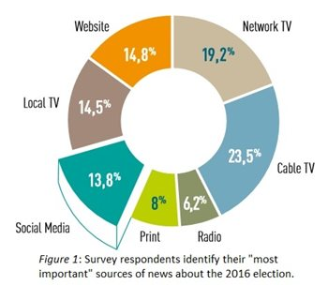
This pie chart shows the various sources of news in US presidential election 2016.

Slide 5
Literature Survey
In 2017 Wang detected the fake news for the first time using machine learning algorithm[1]
In 2019 Zhou et al. researchers concluded that fake news on the internet is rapidly increasing with time. They said that there is need to detect fake news and machine learning algorithms can be used to achieve that[2].
In 2018 Del Vedova et al. concluded that machine learning algorithms can be used to check the contents of the news against some predefined words and then proceed to categorize it as fake or real [3].

Slide 6
Literature Survey (contd.)
In 2020 Kurasinski researched on various machine learning classifiers and concluded that the accuracy of the classifier should be trustworthy before classifying news as fake or real [4] and its training determines the accuracy .
In 2017 Granik & Mesyura detected fake news using Naive bayes machine learning classifier on dataset collected from Facebook posts and that helped them achieve a score of 74% which they said could further be improved [5].

Slide 7
Objective
In this project, we aim to develop a machine learning model that classifies the news stories as fake or real using concepts of Natural Language Processing. Supervised Model will be built using different machine learning algorithms such as SVM(Support Vector Mechanism), logistic Regression.

Slide 8
Problem Identification
A more detailed description of the task is – Given a dataset containing the titles of news articles with their label as real and fake news collected from various sites sources and social media posts , build a ml model that can classify the news as real or fake in and check the accuracy of the model.
Example : Fake news – “If you eat aspirin daily you would stay healthy”.
Real news – “Exercising daily would keep you healthy”.
Above fake news should not be believed at all, otherwise it could have drastic effects on health. So the task is to detect false claims or news before spreading out to the broad areas.

Slide 9
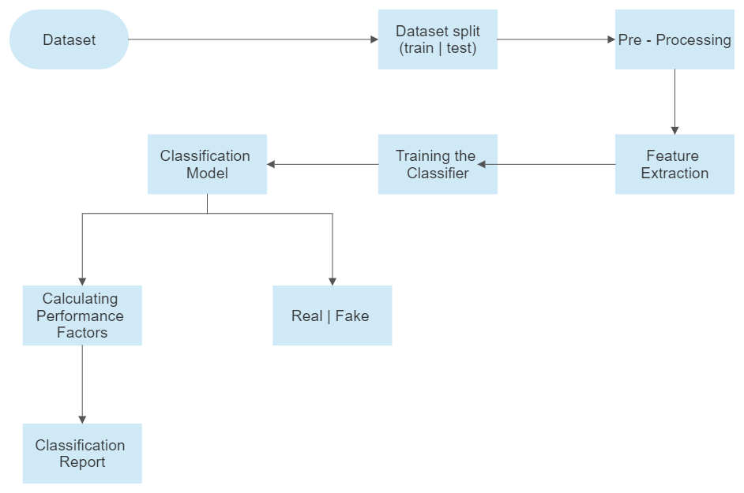
Workflow Diagram

Slide 10
Proposed Work
1. Dataset
The data source used for this project is Kaggle Fake news dataset which contains a single file with csv format for fake and true news articles.
Kaggle is a subsidiary of Google
Contains 4 columns like id, title, author, text and label.
Our dataset contains 20400 news articles out of which 80% is training and 20% is testing data.

Slide 11
2. Pre-Processing
Remove punctuation: Punctuation can provide grammatical context to a sentence which aids in understanding of content.
Tokenization: Tokenizing separates text into units such as sentences or words. It gives structure to previously unstructured text.
Remove Stop words: Stop words are common words that will likely appear in any text. They don’t tell us much about our data so we remove them. Stop words can be or, and, such etc.
Stemming: Stemming helps reduce a word to its stem form. It often makes sense to treat related words in the same way. It removes suffices, like “ing”, “ly”, “s” etc. by a simple rule-based approach.

Slide 12
3. Feature Extraction
Vectorizing:
Vectorizing is the process of encoding text as integers i.e., numeric form to create feature vectors so that these text coded integers can be inputted to machine learning algorithms.
ML algorithms take an input as integers not texts so if news is needed to be inputted into the classifier it must be in numeric form or vectorized form this would help the computer to understand the text.

Slide 13
Performance Metrics
Key performance metrics that are used to evaluate te performance of the trained model are:
Accuracy:
Accuracy=(|TP| + |TN|) / (|TP| + |TN| + |FN| + |FP|)
TP = True Positive, TN=True Negative, FP=False Positive, FN=False Negative
Accuracy is used to measure the efficiency of the classifier. It calculates how many predictions have been correct out of all predictions.
Accuracy is one of most important performance factors for certain type of a dataset.

Slide 14
Performance Metrics (contd.)
Precision = |TP| / (|TP| + |FP|).
TP = True Positive, TN=True Negative, FP=False Positive, FN=False Negative
Precision focuses more on the prediction part as base.
Precision calculates out of all positive classified predictions , how many are true positives or correctly identified as positives.
Recall = |TP| / (|TP| + |FN|)
Recall calculates out of all positives really present in data, how many we got right.

Slide 15
Performance Metrics (contd.)
F1 score:
F1 = 2 x [(Precision x Recall) / (Precision + Recall)].
F1 score represents the trade off between precision and recall.
It calculates the harmonic mean between precision and recall.

Slide 16
RESULT ANALYSIS
COMPARING MODELS
MODEL ACCURACY PRECISION RECALL F1 SCORE
LOGISTIC REGRESSION | 97.67 | 96.38 | 99.07 | 97.7
SVM | 98.9 | 98.64 | 99.17 | 98.9

Slide 17
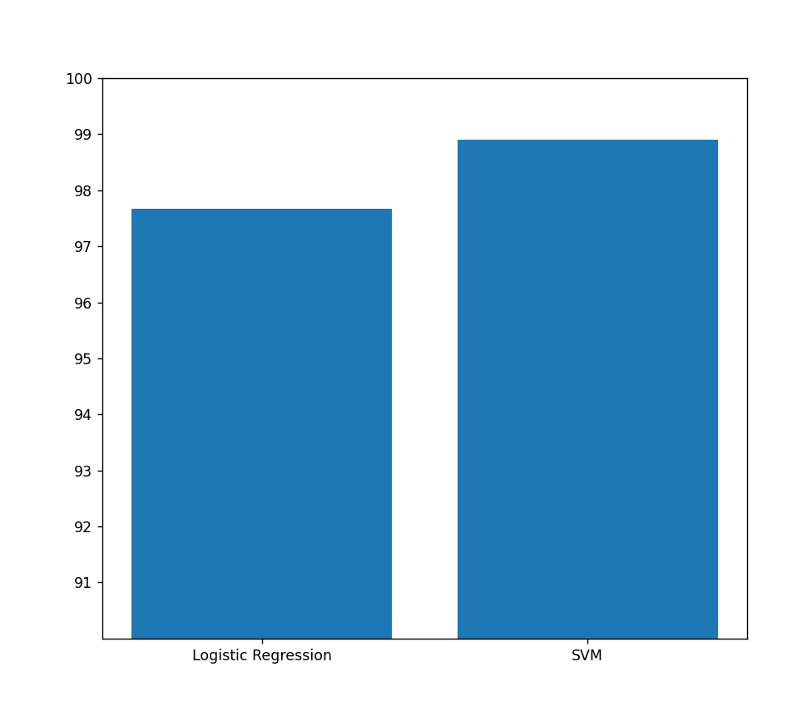
98.9
97.67
RESULT:HENCE, WE OBSERVE SVM OFFERS BETTER PERFORMANCE THAN LOGISTIC REGRESSION
AND SO, OUR MODEL IS BASED ON SVM

Slide 18
Conclusion
The implementation of the ML model has brought us to the result that out of two implemented algorithms in accordance with TF-IDF vectorizer, our best performance algorithm is SVM. It outperformed the Logistic Regression algorithm on this Kaggle fake news dataset.
We can validate this with Classification report and confusion matrix that we have generated for each model.

Slide 19
References
[1]Wang, W. Y. "Liar, liar pants on fire": A new benchmark dataset for fake news detection. Proceedings of the 55th Annual Meeting of the Association for Computational Linguistics, (2017) .
[2] Zhou, X., Zafarani, R., Shu, K., & Liu, H. (2019). Fake News: Fundamental theories, detection and challenges. In WSDM 2019 - Proceedings of the 12th ACM International Conference on Web Search and Data Mining (WSDM 2019 - Proceedings of the 12th ACM International Conference Search and Data Mining). Association for Computing Machinery, Inc.
[3] Donepudi, P. K. (2019). Automation and Machine Learning in Transforming the Financial Industry. Asian Business Review
[4] Granik, M., & Mesyura, V. (2017). Fake news detection using naive Bayes classifier. 2017 IEEE First Ukraine Conference on Electrical and Computer Engineering (UKRCON), Kiev.

Slide 20
THANK YOU

